Slide 1

Lucky Retriever Contacts
COP 4331 Spring 2026
Dr. Yadavally
Small Project – Group 7
February 27, 2026 (12:30 – 12:42)

Slide 2
COP 4331 - Small Project - Group 7
Group Introduction
  Phillip Lintereur (Front-End / PM)
  Andrew Kelton (Front-End)
  Ernesto Lugo (API)
  John-Clement Gallo (API)
  Leandro Vivares (Database / API)
  Kyle Martin (API / Front-End for About Us Page)
Small Project Domain Name
  http://cop4331-pal.com
GitHub Repository
  https://github.com/AndrewKelton/Small-Project

Slide 3
COP 4331 - Small Project - Group 7
Presentation Outline
  Project and Web App Overview
    Project Requirements
    Web App Overview
    Project Progress Schedule and Summary
  Database
  API
    API End Point Demonstration
  Front-End
    Web App Demonstration

Slide 4
COP 4331 - Small Project - Group 7
Project Requirements
  Web App that serves as a Contacts Management System
  LAMP Stack
    Hosted on Digital Ocean Droplet
  Functionality
    Login/Register
    CRUD Operations - Create, Read, Update, Delete
    Search Function (Partial Match)
  Contact Information
    First Name, Last Name, Email, Phone Number, Date Contact was Added
  Use API’s for communication between client and remote server
  Request/Response Packages using JSON

Slide 5
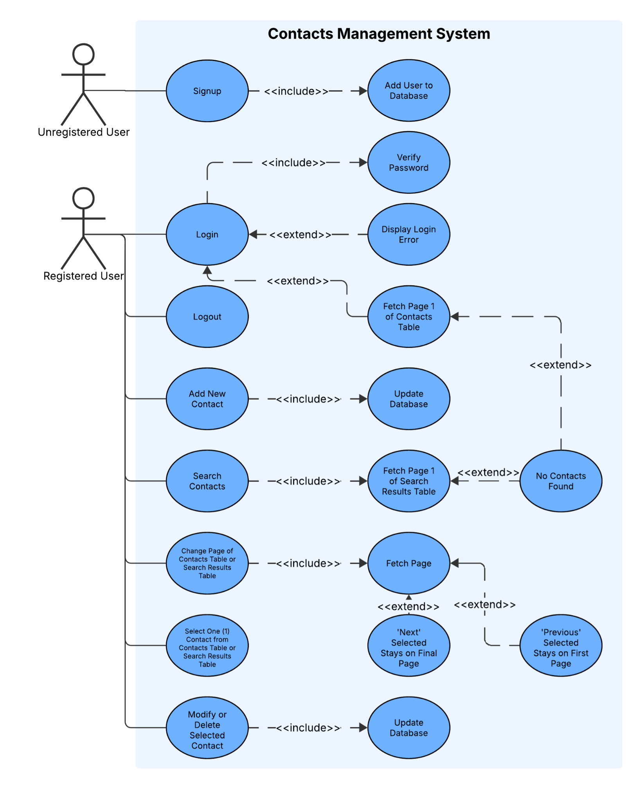
COP 4331 - Small Project - Group 7
Use-Case Diagram
  System
    Web-App (Contacts Management System)
  Actors
    Unregistered User
    Registered User
  Use-Cases
    What functions does the system provide?

Slide 6
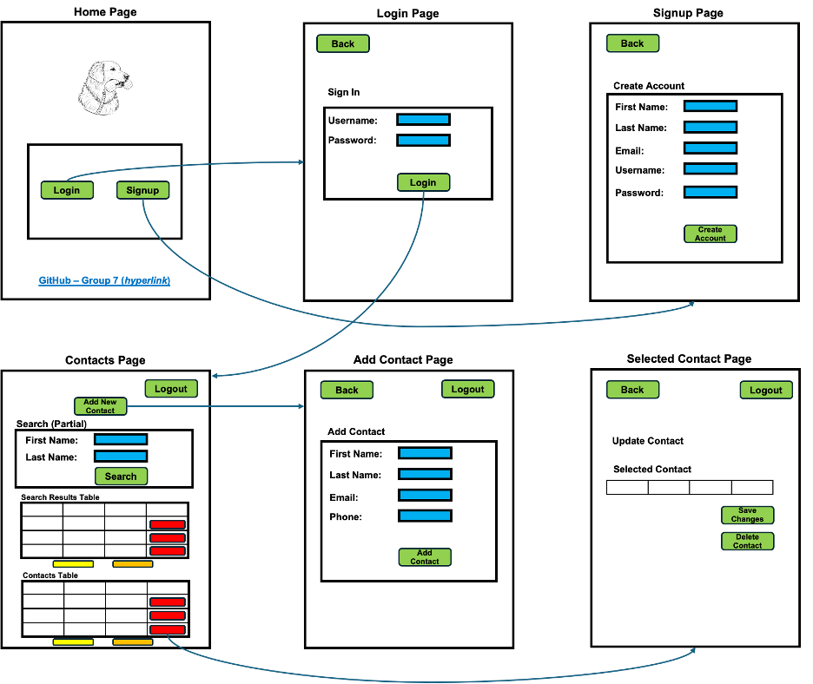
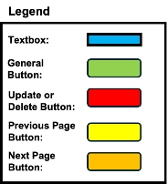
COP 4331 - Small Project - Group 7
Web App Layout
  System Design
    Wireframe
    Functional Specifications

Slide 7
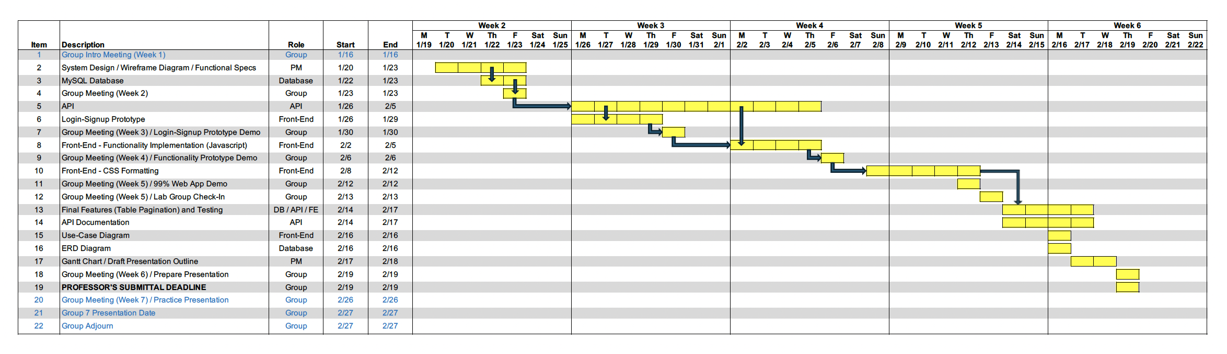
COP 4331 - Small Project - Group 7
Gantt Chart
  Group Coordination – Weekly Meeting and Discord
  Program Progress and GitHub Protocol

Slide 8
COP 4331 - Small Project - Group 7
Things that went well
  Overlapping of workflow and prototyping sped up production.
  Got into a rhythm after getting a few key features implemented on the front-end.
  Generally met key deadlines towards the end of the project
    Functionality Prototype
    Final CSS Formatting by Lab Group Check-In
Things that could have gone better
  git took time to adjust to, which slowed testing of features.
  Missing a critical requirement (limit on loading contact table) late in the project.
    Challenge with table paging edge-case

Slide 9
COP 4331 - Small Project - Group 7
Database
  Database Description
  MySQL
  AI Disclosure
  Entity Relationship Diagram (ERD)

Slide 10
COP 4331 - Small Project - Group 7
Database
  Entity Relationship Diagram (ERD)

Slide 11
COP 4331 - Small Project - Group 7
API
  API Overview
    REST API
    JSON Client-Server Communication
    PHP
    SwaggerHub
    Postman
    AI Disclosure

Slide 12
COP 4331 - Small Project - Group 7
API
  API Documentation

Slide 13
COP 4331 - Small Project - Group 7
API
  API End-Point Demonstration

Slide 14
COP 4331 - Small Project - Group 7
Front-End
  JavaScript
  HTML
  CSS and Bootstrap 5
  AJAX (asynchronous API calls)
  Localhost Testing (XAMPP)
  AI Disclosure

Slide 15
COP 4331 - Small Project - Group 7
Front-End
  Demonstration

Slide 16
COP 4331 - Small Project - Group 7
Front-End
  Lighthouse Accessibility Report

Slide 17
COP 4331 - Small Project - Group 7
About Us Page

Slide 18
COP 4331 - Small Project - Group 7
  Questions?

